Slide 1
Bottlenecks in increasing network speeds
Tariq Toukan
Netdev 0x13, March 2019, Prague

Slide 2
Agenda
Motivation
PCI bottleneck:
  Bottleneck description
  HW features for improved PCI utilization:
    RX completion descriptors compression
    TX descriptors bulking
CPU bottleneck:
  Page allocator review
  Bottleneck description
  Ideas and solutions

Slide 3
Motivation

Slide 4
Motivation
NIC speeds are getting really high:
  NIC speed of 100Gbps is out there for a few years…
  Current state-of-the-art speed is 200Gbps
  Next generation NICs are going to be 400Gbps
Higher packet rate ➔ less time to spend processing a packet
The stack needs to be on par with such processing rates

Slide 5
Motivation
These high NIC speeds come with a variety of new challenges
and expose bottlenecks in several components
A network’s performance is limited by its weaker SW/HW layer or component
Hence, bottleneck analysis and addressing is essential to fully utilize the NICs linerate
Important:
  Do not wait until you hit the bottleneck
  Prepare in advance
Bottleneck analysis is the key stage that leads to deep discussions
end up with plans / tasks / roadmap of innovative features.

Slide 6
PCI bottleneck

Slide 7
PCI generations
Supported speeds and encoding
Gen | Introduced | Encoding | Speed | Throughput (per Width) [Gb/s]
 |  |  |  | x1 | x2 | x4 | x8 | X16
1 | 2003 | 8/10 | 2.5GT/s | 2.00 | 4.00 | 8.00 | 16.00 | 32.00
2 | 2007 | 8/10 | 5GT/s | 4.00 | 8.00 | 16.00 | 32.00 | 64.00
3 | 2010 | 128/130 | 8GT/s | 7.88 | 15.75 | 31.51 | 63.02 | 126.03
4 | 2017 | 128/130 | 16GT/s | 15.75 | 31.51 | 63.02 | 126.03 | 252.06
5 | TBA | 128/130 | 32GT/s | 31.51 | 63.02 | 126.03 | 252.06 | 504.12

Slide 8
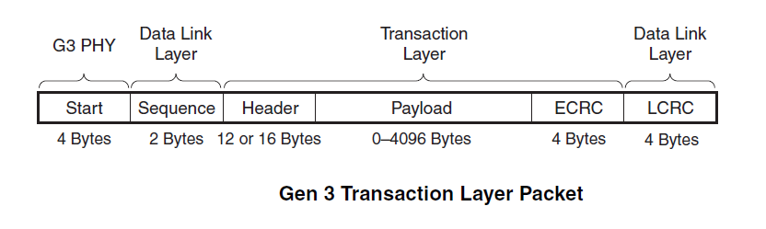
PCI bottleneck
PCI Express 3.0 x16 width link throughput is ~126Gbps
PCI data transfer overhead:
Symbol encoding: 128/130, ~1.5% overhead
Headers, Error correction protocols
MPS (Max_Payload_Size) is relatively small= 256 bytes

Slide 9
PCI bottleneck
No enough room for a 100Gbps NIC to reach linerate
with the typical layout of datapath descriptors
  RX descriptors
  TX descriptors
  Completion descriptors
The smaller the packets size, the higher the descriptors overhead
This demands new, innovative, bits-economic layout for the descriptors.

Slide 10
HW features for improved PCI utilization

Slide 11
The key idea
The HEART of the features is the following idea:
  You already use some moderation and do operations in bulks,
  take advantage of this and reduce overhead of the descriptors!
HW Features:
RX completion descriptors compression
TX descriptors bulking

Slide 12
RX completion descriptors compression
Goal:
Reduce RX PCI overhead by reducing the data to completions ratio.
How it works:
A compression session: Multiple almost identical completions are merged and compressed.
Per a compression session, information that is shared between the completions is written only once.
Only the unique information (small) is written per completion (mini-completion).
Successful compressing improves message rate, especially for small packet traffic.

Slide 13
RX completion descriptors compression
Before
After
Completion #1
Completion #2
Shared completion information
mini-comp #1
mini-comp #2
mini-comp #3
mini-comp #4
mini-comp #5
mini-comp #6
mini-comp #7
mini-comp #8
64bytes
64bytes
64bytes
64bytes

Slide 14
RX completion descriptors compression
Packet rate test:
Client: Small (64Bytes) UDP multistream
Server: XDP_DROP (xdp1)
Before: 83 Mpps
After: 130 Mpps
+47 Mpps, +57%
Introduced (way back…) in kernel v4.7.
Recently gained extra significance,
with the packet rate XDP allows.
Today, controlled via ethtool private flags:
  ethtool --set-priv-flags eth0 rx_cqe_compress on
Ideally, API is standardized within a tool: ethtool? devlink?

Slide 15
TX descriptor bulking
Goal:
Reduce PCI overhead in TX by combining transmit descriptors
How it works?
Enable sending multiple packets using a single TX descriptor
The new TX descriptor has two parts:
  A shared control segment
  Multiple data segments, one per packet, containing packet-specific info:
    dma_addr, size.
Very significant when transmission is requested in bulks
  XDP_REDIRECT:
    #define DEV_MAP_BULK_SIZE 16
    #define CPU_MAP_BULK_SIZE 8
  XDP_TX: bulk up to a NAPI budget

Slide 16
TX descriptor bulking
Supported by Mellanox NICs ConnectX-5 and newer.
Starting from kernel v5.0.
Control
Data segment #1
Alignment
Control
Data segment #2
Alignment
Control
Data segment #1
Data segment #2
Data segment #3
Data segment #4
Data segment #5
Data segment #6
64bytes
64bytes
64bytes
64bytes

Slide 17
TX descriptor bulking
Packet rate test:
Client: Small (64Bytes) UDP multistream
Server: XDP_TX (xdp2)
Before: 70 Mpps
After: 116 Mpps
+46 Mpps, +66%

Slide 18
TX descriptor bulking
Packet rate test:
Client: Small (64Bytes) UDP multistream
Server: XDP_REDIRECT
Before: 64 Mpps
After: 92 Mpps
+28 Mpps, +44%

Slide 19
CPU bottleneck:
The Linux Page allocator

Slide 20
The Linux page allocator
General component, serves all subsystems.
The kernel often needs contiguous memory areas that span multiple page frames, so when serving memory allocation requests, it must minimize external fragmentation.
This is the task of the buddy allocator.
Concurrent accesses are synced by a zone spinlock:
struct zone {
...
/* Primarily protects free_area */
spinlock_t lock;
...
};

Slide 21
The Linux page allocator
Need to reduce the frequency of accesses to the zone->lock.
Kernel provides a layer of local, per-CPU, page list
  PCP: Per-CPU Pagelists
Page alloc:
  Kernel asks the local PCP for a page
  If no page is available, the PCP asks for a batch of pages from the buddy system
    Under zone->lock
Page free: Symmetric
  Kernel releases the page to the local PCP
  If PCP is full: free a batch of pages back to the buddy system
    Under zone->lock

Slide 22

The Linux page allocator
struct zone {
...
/* Primarily protects free_area */
spinlock_t lock;
...
};
When PCPs satisfy the local page alloc/free requests, no zone->lock contention.
BUT… is that always the case?
buddy
PCP
core 0
PCP
core 1
PCP
core 2
PCP
core 3
. . . . .
PCP
core n-1
PCP =
Per-CPU Pagelists

Slide 23
Bottleneck analysis: Typical network flow
Per receive ring, device driver allocates pages (from the local PCP)
SKBs created and passed to the network stack
Once done, SKB’s pages are released (to the local PCP)
However…
Stack processing contains several scheduling points
SKB handling and release can be completed on a different core
This repeated pattern causes PCPs imbalance:
PCP X gets empty: keeps asking the buddy system for more pages
PCP Y gets full: keeps returning pages to the buddy system
High zone->lock contention
buddy
imbalance!
imbalance!
PCP
core X
PCP
core Y
page allocate
page release

Slide 24
Bottleneck analysis: Test and monitor
Setup:
  NIC: ConnectX-5 100Gbps, back-to-back
  CPU: Intel(R) Xeon(R) CPU E5-2680 v3 @ 2.50GHz
  48 cores
  12 receive rings
  Traffic: 240 netperf instances, TCP stream
  Kernel 5.0.0-rc3+
    modified mlx5e driver: disabled page-allocation optimizations
  MTU = 750B ⬅ simulates the packet rate of a 200Gbps NIC
Observation: Two types of cores
  NAPI + netserver: page allocate + page release
  netserver only: page release
Bandwidth: 40 Gbps, too low

Slide 25
Bottleneck analysis: Test and monitor
# sudo perf stat -a -r 10 -e kmem:mm_page_alloc -e kmem:mm_page_free sleep 1
Performance counter stats for 'system wide' (10 runs):
7025086 kmem:mm_page_alloc
7143334 kmem:mm_page_free
# sudo perf stat -C 1 -r 10 -e kmem:mm_page_alloc -e kmem:mm_page_free sleep 1
Performance counter stats for 'CPU(s) 1' (10 runs):
586712 kmem:mm_page_alloc
10071 kmem:mm_page_free
# sudo perf stat -C 25 -r 10 -e kmem:mm_page_alloc -e kmem:mm_page_free sleep 1
Performance counter stats for 'CPU(s) 25' (10 runs):
1 kmem:mm_page_alloc
224068 kmem:mm_page_free
Imbalanced PCP
Imbalanced PCP

Slide 26
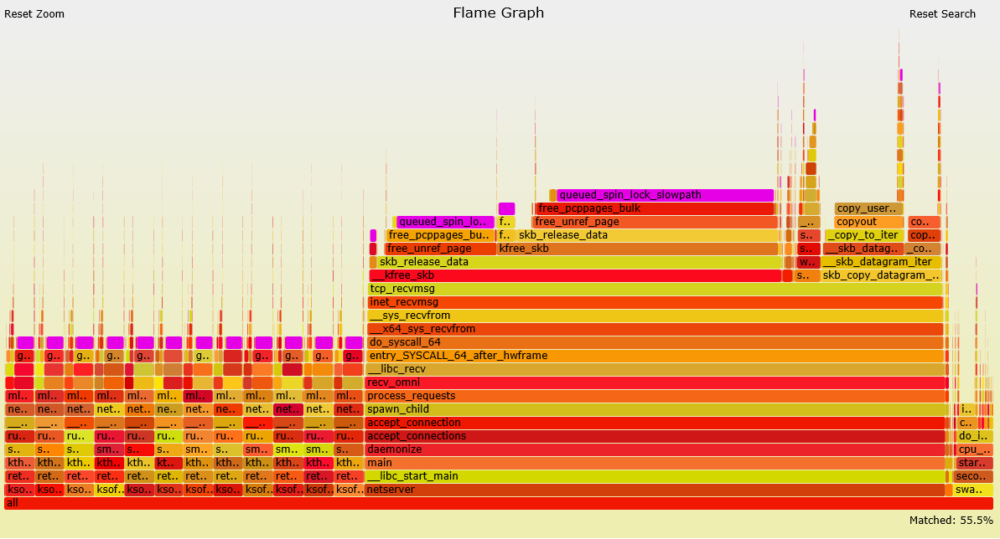
Bottleneck analysis: Test and monitor
System-wide, all cores
spinlock: ~55% of samples

Slide 27
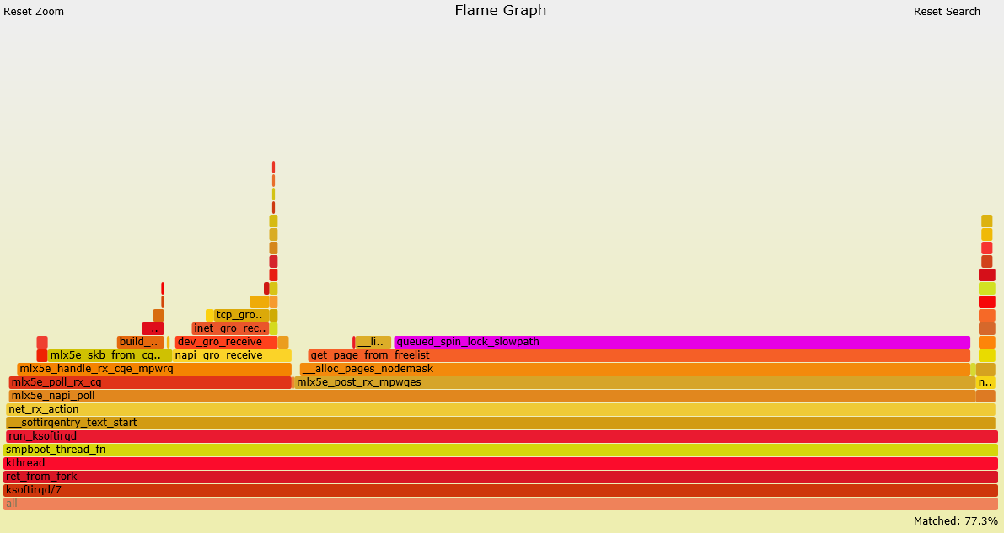
Bottleneck analysis: Test and monitor
NAPI processing
spinlock: ~77% of samples

Slide 28
The page allocator bottleneck:
Ideas and solutions

Slide 29
Intro: page_pool API
By Jesper Dangaard Brouer:
https://github.com/xdp-project/xdp-project/blob/master/areas/mem/page_pool01_evolving_API.org
Under net subsystem
Introduced in kernel v4.18
Goals:
Keep pages DMA-mapped (driver only use DMA-sync where needed)
Faster recycle API than page-allocator
Common allocator API for simplifying NIC drivers
Better integration with network stack, not just XDP usage
Most of the ideas in the following slides are to be integrated in the page_pool.

Slide 30
Page reuse
In-driver feature, achieves better page utilization
A fundamental and easy technique to reduce the page allocation rate
Use the 4KB page for two MTU packets
  For default MTU of 1500B
Striding RQ:
An advanced and powerful HW feature supported since ConnectX-4 LX
Improves both memory and PCI utilization

Slide 31
Page recycle
Maintain a waiting queue of the allocated pages
When a new page is needed, first check internally for an available one
Usually done by elevating the page reference counter
The page is available for recycle when its refcount gets back to 1
Issues:
No signaling/callback mechanism:
  must keep observing the refcount upon allocations
Head-of-the-queue blocks:
  Might be caused for several reasons. No clear policy to deal with it.
Still helpful: when traffic pattern and processing times are known/expectable,
tune the recycle-queue size to get high recycle rate.

Slide 32
Page remote release
An intriguing idea focuses on preventing the PCP imbalances
  Suggested by Eric Dumazet
Idea: use a page-return hook to directly release the page back to where it originates
Save minimal amount of metadata (the originating core number) within the SKB structure
Use it upon SKB release
Recent direction is to integrate the idea into the page_pool API instead.
Save a pointer to the originating page_pool structure, instead of core id.
Two proposed places for the page return hook:
  Page allocator layer via put_page()
  Network stack layer via kfree_skb()
  https://github.com/xdp-project/xdp-project/blob/master/areas/mem/page_pool02_SKB_return_callback.org

Slide 33
Optimize zone lock critical section
Orthogonal effort in the Memory Management (MM) subsystem.
RFC by Aaron Lu:
  https://github.com/aaronlu/linux/tree/zone_lock_rfc_v3
The key idea is to avoid touching pages struct page under the global zone lock
  because cache miss on the struct is the most time consuming part under the lock.
Suggestion is, don’t do merge operations on free path
  as it causes multiple struct page's to be fetched under the zone lock.
This opens the opportunity of doing cluster allocation on allocation path
  allocate a batch of pages under zone lock without needing to touch every single struct page of them.
This makes the system favor order-0 alloc/free
Perfectly matches the standard buffer size used in the networking stack

Slide 34
Optimize zone lock critical section
Accepted patches:
Improvements (v4.17)
97334162e4d7 mm/free_pcppages_bulk: prefetch buddy while not holding lock
0a5f4e5b4562 mm/free_pcppages_bulk: do not hold lock when picking pages to free
Fix (v5.0-rc1)
65895b67ad27 mm/page_alloc.c: free order-0 pages through PCP in page_frag_free()

